Slide 1
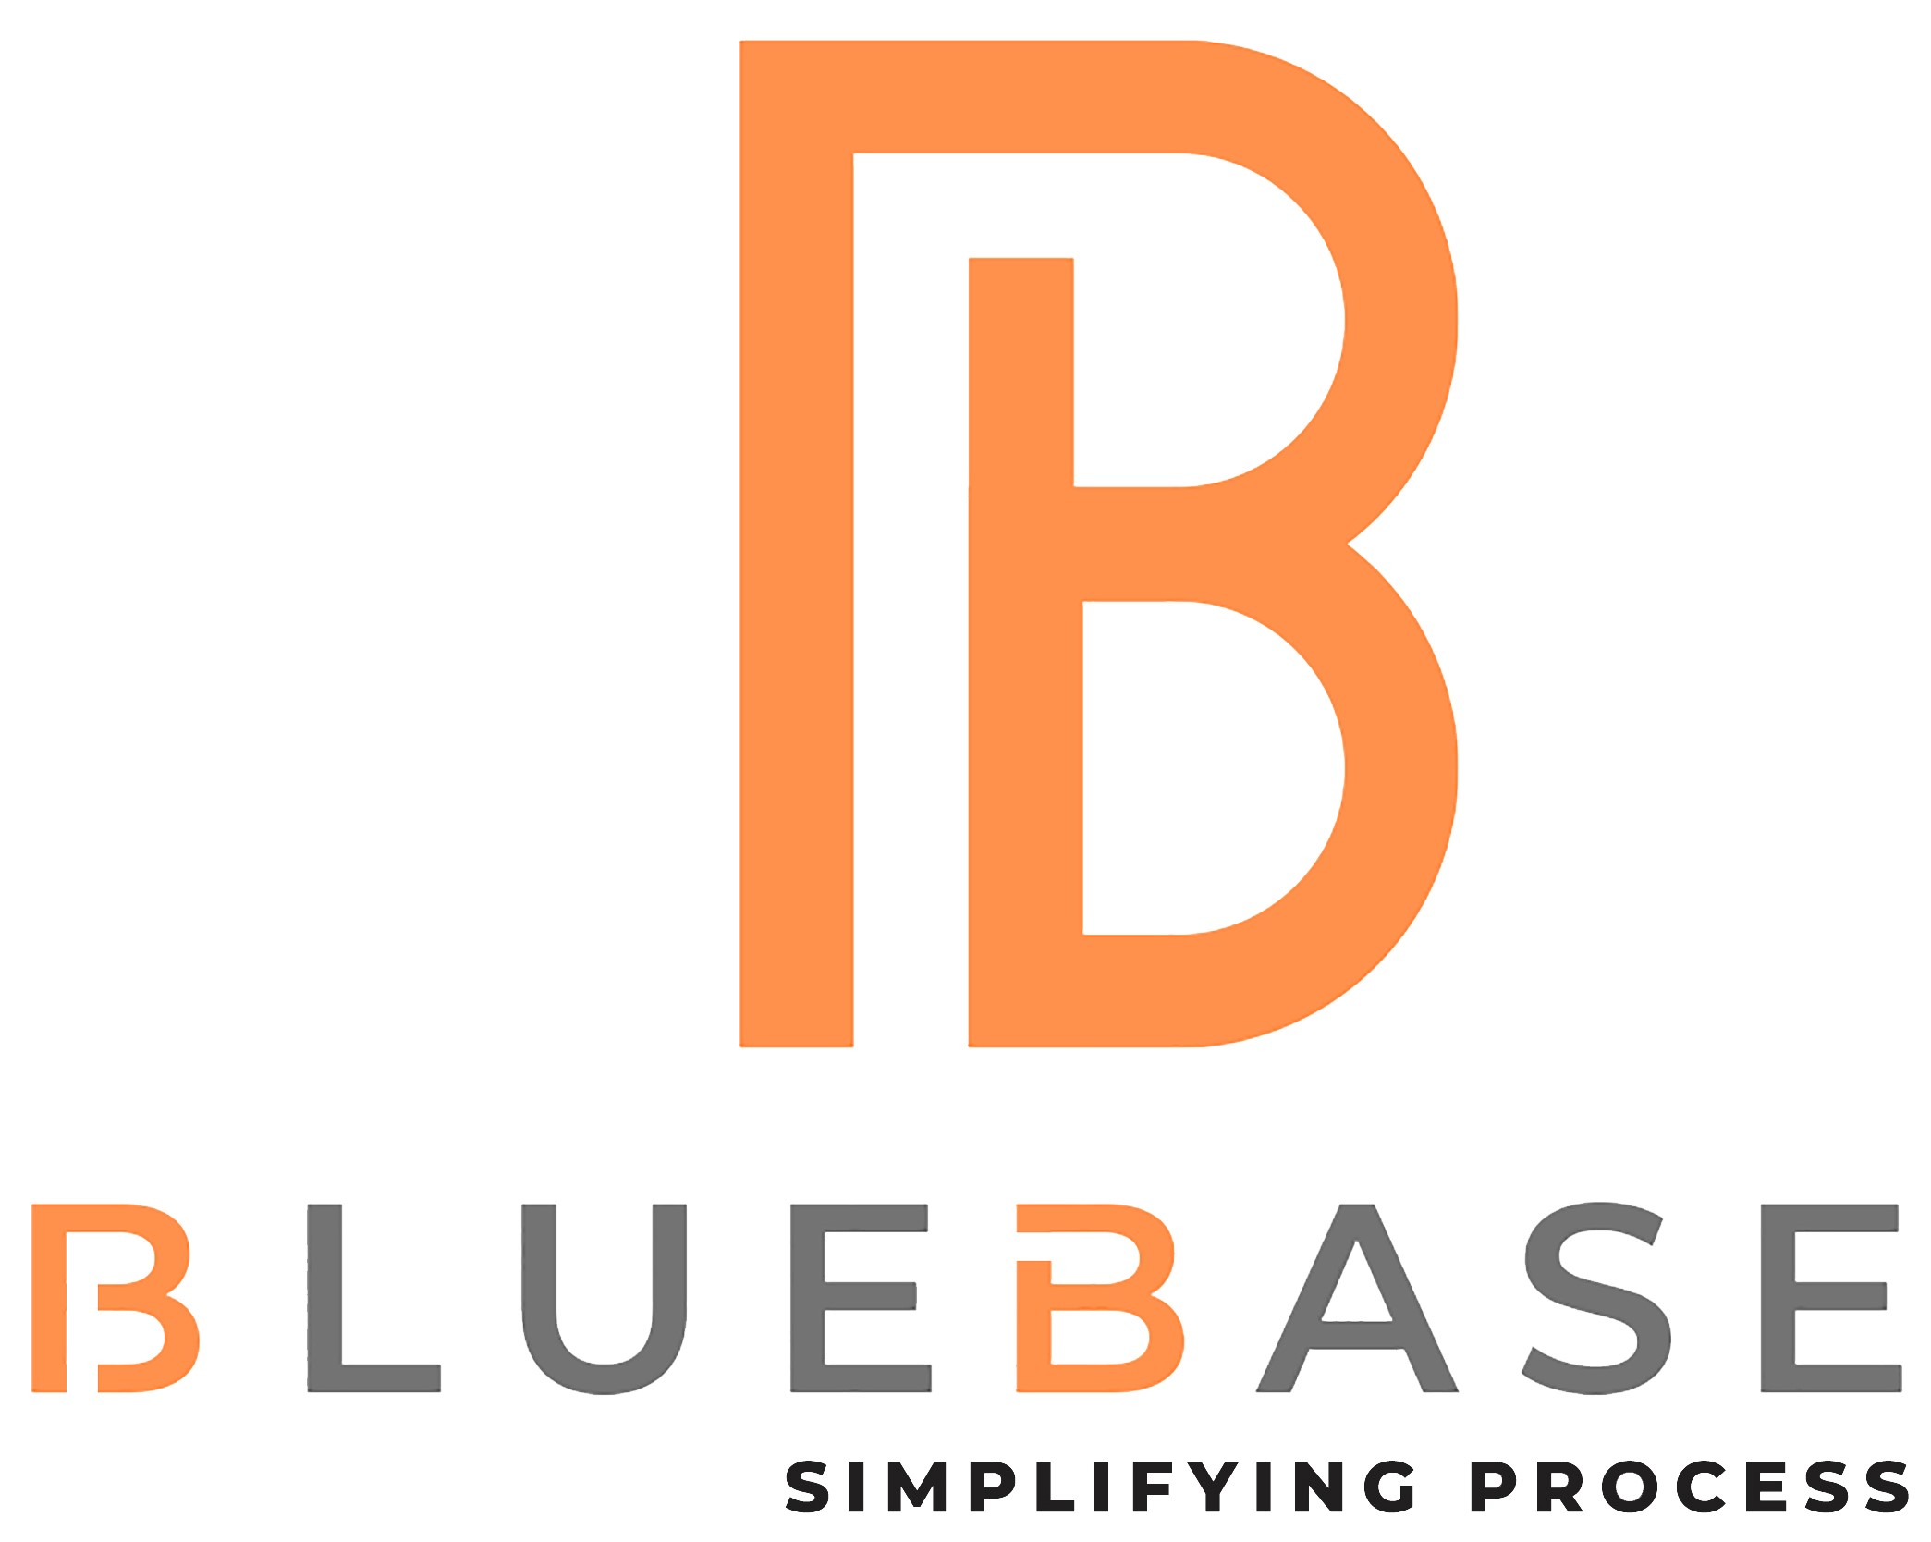
Bluebase Software Services Pvt Ltd is a part of Quadsel Group (Estd. 1996). We are a leading Software Solution company in developing customized IT solutions and the Solution Developed should also Facilitate Enhanced End-User Experience in Usability, Availability, and Accessibility. We work closely with a wide range of clients from different sectors across the globe.

Slide 2
BLUEBASE PRODUCTS
KERLI HRMS & Payroll
CLMS
(Contract Labour Management)
Thrift Society (Banking & Manufacturing)
Self Service Portal (Manufacturing)
ISO Audit Software
Canteen Management
Visitors Management
Dynamic Ecommerce Website
Branding

Slide 3
KERLI Human Resource Management System (HRMS) portal is Web-Based Solution for HR & Management to Access and Maintain The Organization Details Effortless and Utilise their time Efficiently.
KERLI
HRMS
RESOURCING
SCHEDULE INTERVIEW
ONBOARDING
INDUCTION
TRAINING
LEAVE MANAGEMENT

Slide 4
KERLI
PAYROLL
ATTENDANCE
PAYROLL GENERATION
COMPLIANCE
SATUTORY
SCALE
MASTERS
REPORTS

Slide 5
CLMS
Contract Labour
Management
Contract labour management system is a web based system for employers to have a better check and control over their contractors and the labour under them.

Slide 6
Credit & Thrift Society is a software product exclusively designed and developed for Credit Co-operative Credit Societies. Its fully Real time Web--based application having high tech features
CREDIT &
THRIFT
SOCIETY

Slide 7
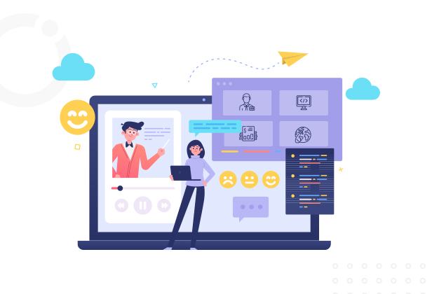
SELF
SERVICE
PORTAL
Employee self-service (ESS) portals is web-based tools through which employees can access relevant information and conduct certain transactions from a central online site

Slide 8
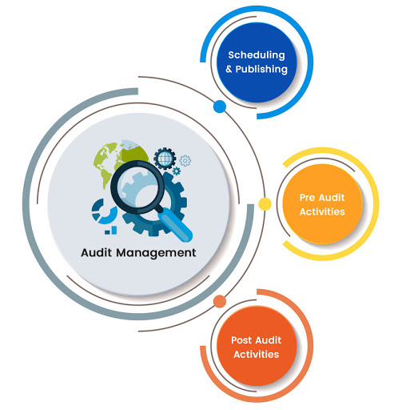
ISO audit software integrates every audit step preparation, scheduling, execution, findings, verification, and completion necessary for your organization.
ISO
AUDIT
SOFTWARE

Slide 9
CANTEEN
MANAGEMENT
Canteen Management Software Enables All The Activities Of The Canteen And Maintain A Detailed Account Of Food Served At The Canteen

Slide 10
Maintain Security & Safety Protocols While Creating An Inviting Experience For Guests & Reduce Your Security And Compliance Risk of an Organization
VISITORS
MANAGEMENT

Slide 11
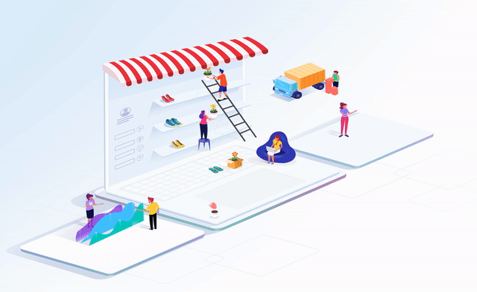
DYNAMIC & ECOMMERCE WEBSITE

Slide 12
BRAND OPTIMIZATION & MARKETING
SEO
Search Engine Optimization
SEM
Search Engine Marketing
SMO
Social Media Optimization
SMM
Social Media Marketing

Slide 13
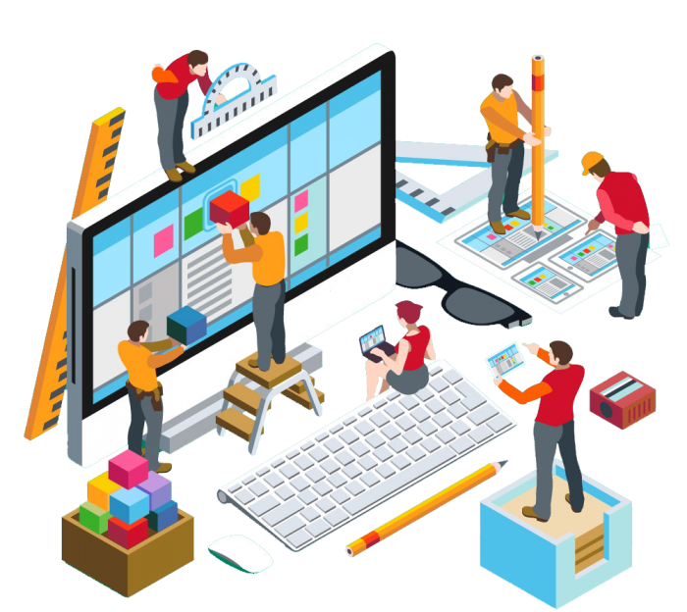
Customised software is software that is specially developed for some specific organization or other user.
CUSTOMISED SOFTWARE

Slide 14
MOBILE APP DEVELOPMET
REACT
ANDROID
iOS
Mobile app development is the act or process by which a mobile app is developed for mobile devices, such as personal digital assistants, enterprise digital assistants or mobile phones.

Slide 15
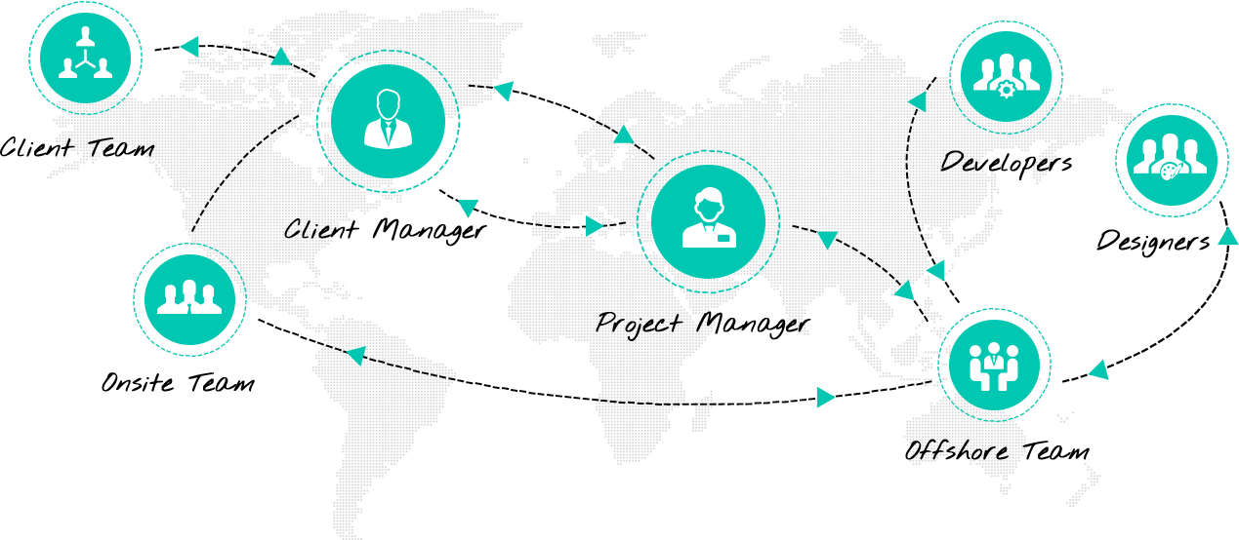
OFFSHORE
TEAM

Slide 16
ROBOTIC
PROCESS
AUTOMATION
Robotic process automation is a form of business process automation technology based on metaphorical software robots or on artificial intelligence /digital workers.

Slide 17
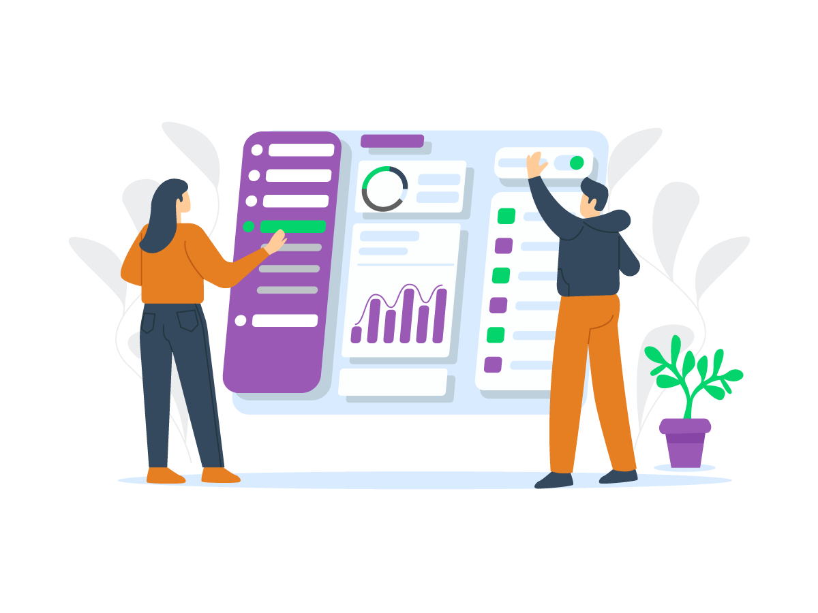
DYNAMIC
DASHBOARD
A Dynamic Dashboard enables multiple users to access a dashboard that was previously accessed only by a single static user.

Slide 18
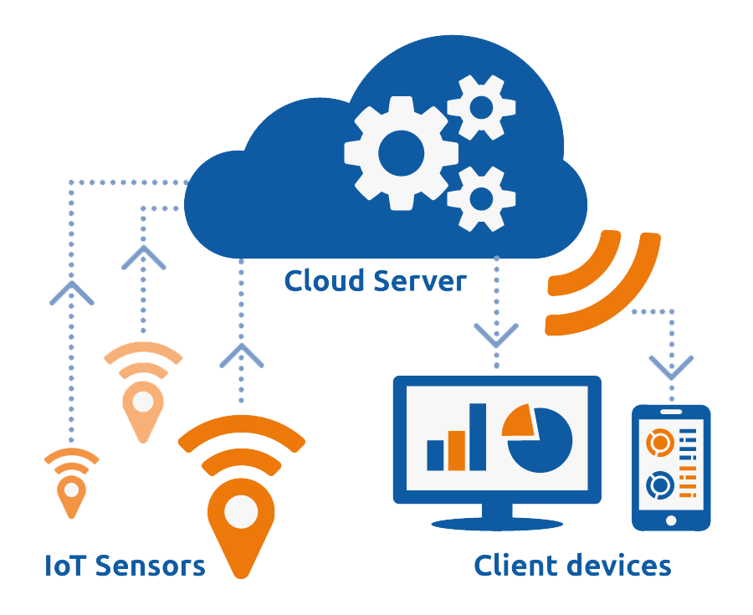
I O T
Internet Of Things
The Internet of things describes the network of physical objects-"things“-that are embedded with sensors, software, and other technologies for the purpose of connecting and exchanging data with other devices and systems over the Internet.

Slide 19
CLIENTELE

Slide 20
Thank you
+91 9841416638
info@bluebase.in
www.bluebase.in

